Slide 1
AOH ORGANIZER SEMINAR “The Future is NOW”

Slide 2
INTRODUCTION

Slide 3
Objectives
Acknowledge Decline in Membership
Define Reasons for Decline
Obtain Effective Recruiting Techniques
Obtain Effective Retention Techniques
Gain R/R Tactics for Targeted Groups
Learn Emerging Tech. Tools
BE PART OF THE SOLUTION

Slide 4
TOPICS
RECRUITMENT & RETENTION OVERVIEW
GRASSROOTS RECRUITING
RECRUITMENT TABLES
R & R FOR COLLEGES
R & R FOR MILITARY INSTALLATIONS
EMERGING TECH.
R & R THINK TANK

Slide 5
AOH ORGANIZER’S SEMINAR
TODAY’S PRESENTERS-

Slide 6
Module
ONE

Slide 7
ORGANIZER OVERVIEW

Slide 8
National Organizer’s Duties
AOH NATIONAL CONSTITUTION
ARTICLE X Sec 12 (page 12
-Conduct Organization Department
-Encourage the Organization of new divisions especially in Counties, States and Districts where no Division exists.
Report to the National Convention and National Meetings

Slide 9
Duties of State, District, County and Div. Organizers
-Direct Organizational work within their respective Jurisdictions and perform other duties as may be required by Jurisdictional By-Laws

Slide 10
MODULE
ONE

Slide 11
AOH MEMBERSHIP DECLINE
REASONS
Aging Demographics
Society Changes
Family Commitments
Generational Changes
POOR RETENTION
POOR RECRUITMENT

Slide 12
AOH Membership Nationwide

Slide 13
OVERCOMING AGING DEMOGRAGHICS
-Recruitment Younger
-Targeting Recruitment

Slide 14
Overcoming Society Changes
-Find Like Minded People (Churches)
-Get out into the Public
-Fairs, Festivals
-Community Service Project
-Positive Media
-Use the Web

Slide 15
FAMILY COMMITMENTS
-Movie Nights
-Potluck Dinners
-Daytrips
-Educational Series
-Cultural Events (ceili, set dance lessons)
-Junior Divisions

Slide 16
Overcoming Generational Changes
-Understand the Millennial
(Different view of Church)
(Community Breakdown)
-Don’t be “That Old Guy”
-Mentor
-Involve Younger Members
THE FUTURE OF OUR ORDER DEPENDS ON THIS

Slide 17
OVRCOMING POOR RETENTION
-Develop a Mentor Plan (Sponsor)
-Have an Orientation for New Members
-Learn Names (Name tags)
-Learn Their Interests
PROVIDE A REASON TO STAY

Slide 18
OVERCOMING Poor Recruiting
-Develop a Plan
-Plan 3 Events
-Make it Appealing to the Eye
-Use Materials
Learn from Others

Slide 19
One on One Recruiting
-Personalize it
-Speak to their interests
-Find a common Ground

Slide 20
Nashville Success

Slide 21
MODULE
Two
Grassroot Recriuting
Credit Don Connelly DC Organizer

Slide 22
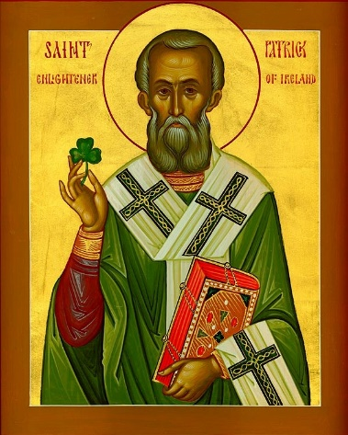
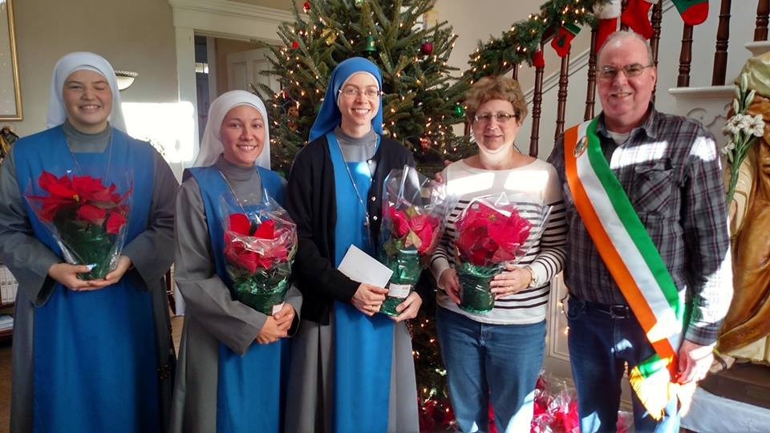
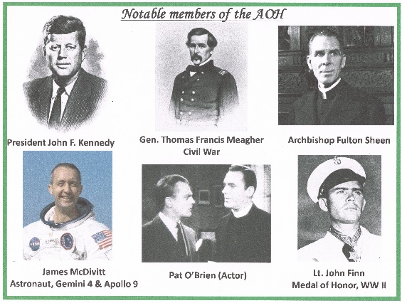
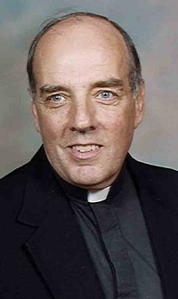
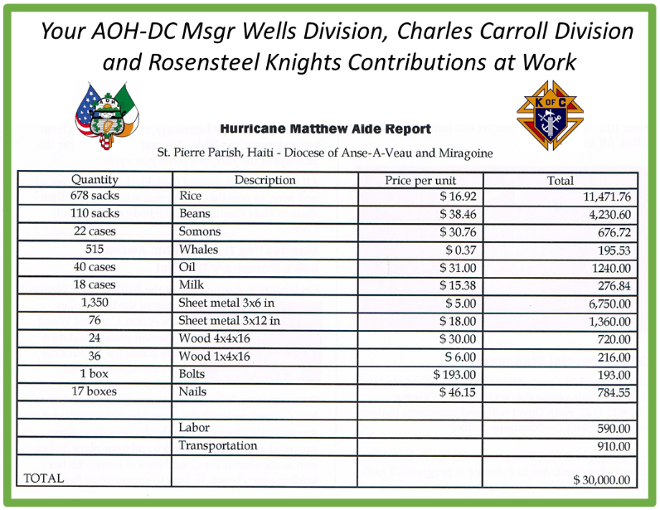
Displays
Heritage
Faith
Service

Slide 23
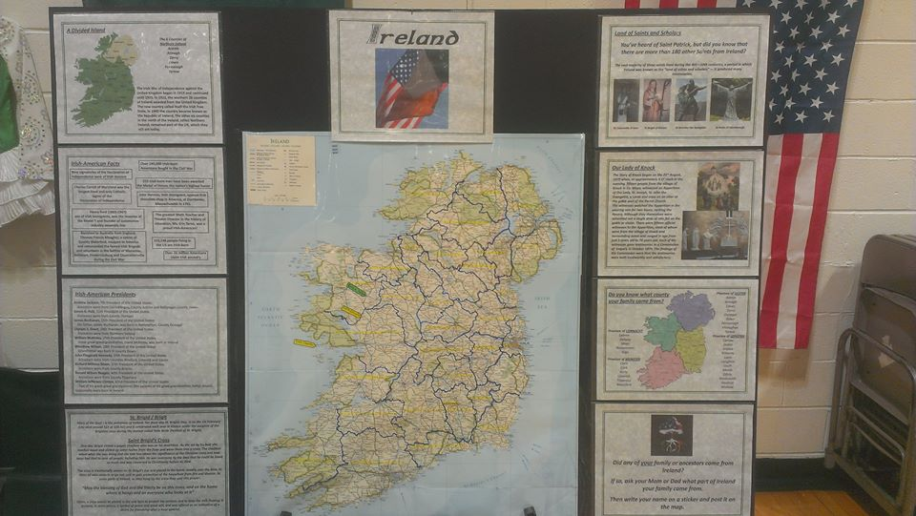
Starting the Conversations
The Map Board

Slide 24
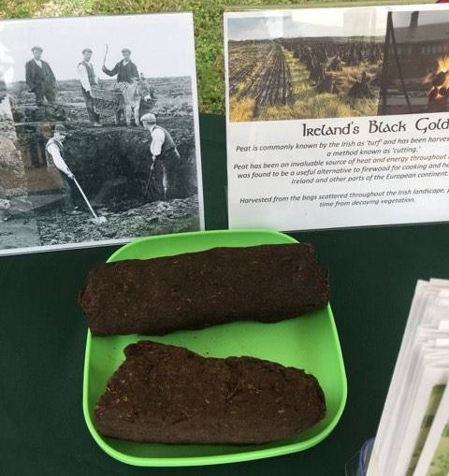
Starting the Conversations
The Turf Display

Slide 25
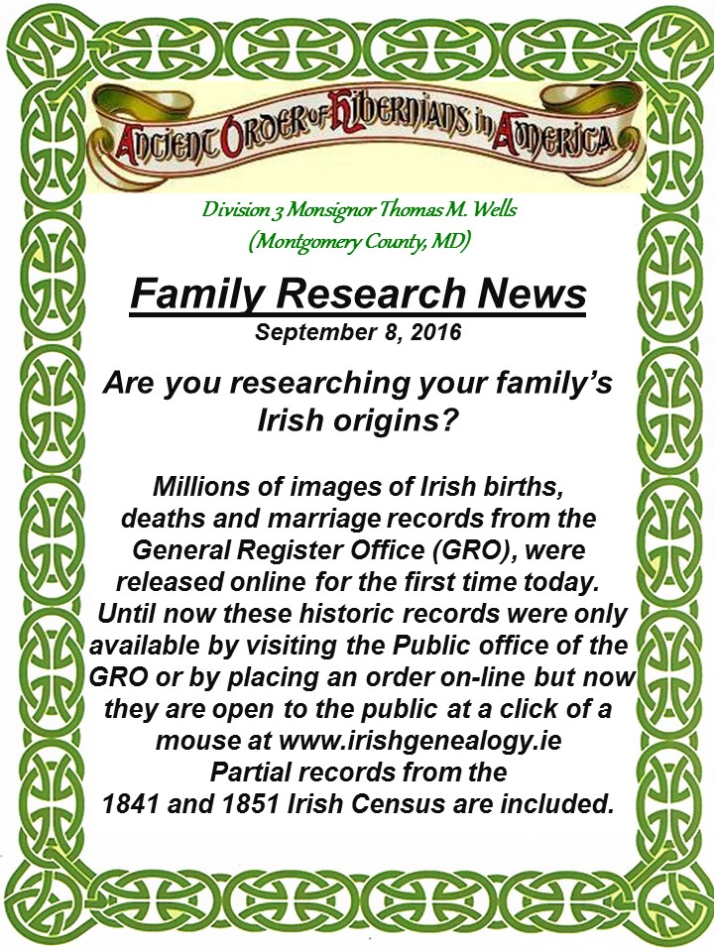
Starting the Conversations
Family Heritage

Slide 26
St Bernadette Fall Festival

Slide 27
St John the Baptist Community Sunday

Slide 28
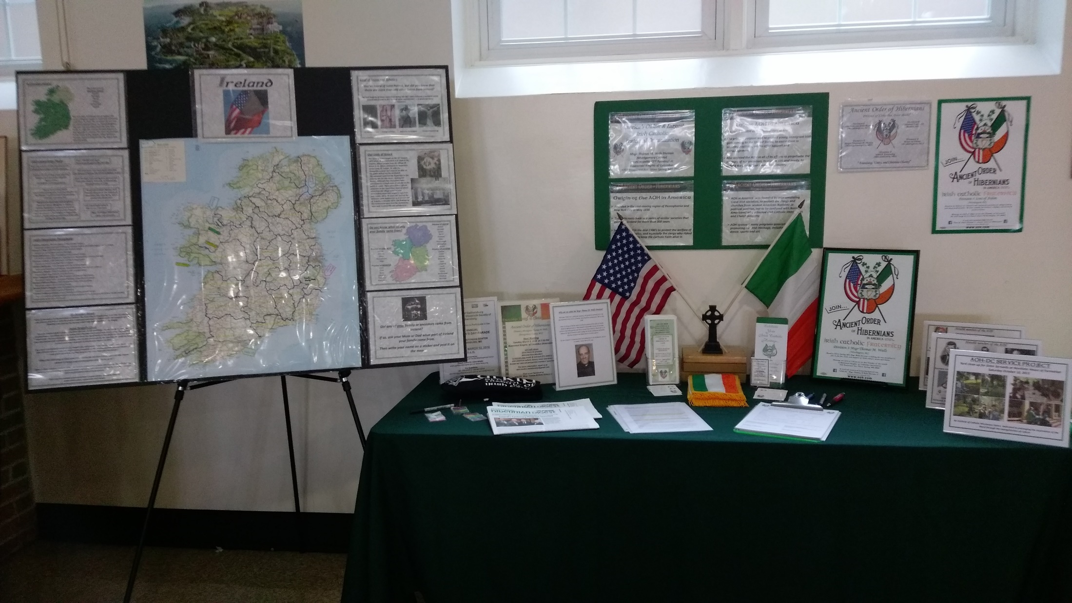
St Jerome’s Irish Festival

Slide 29
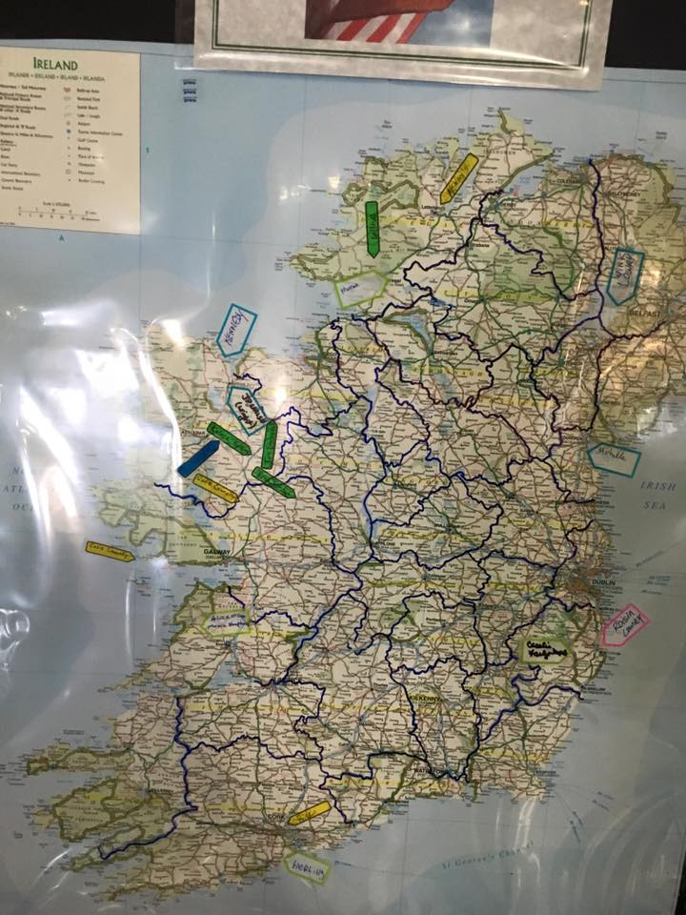
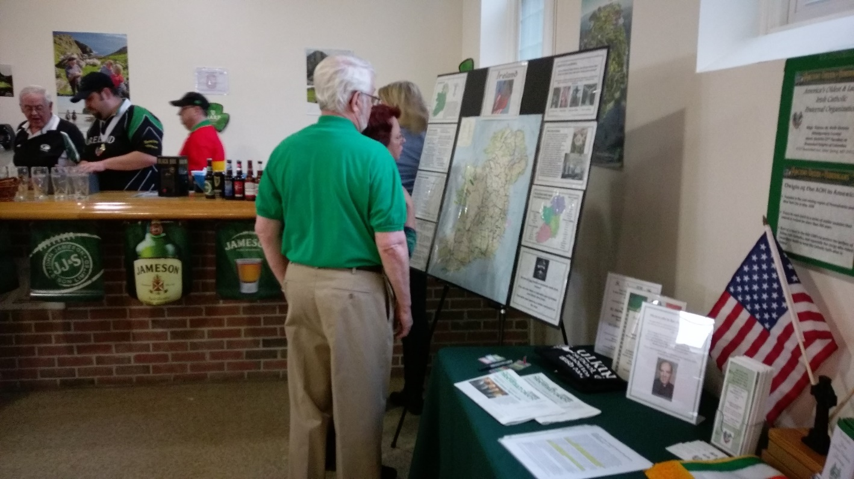
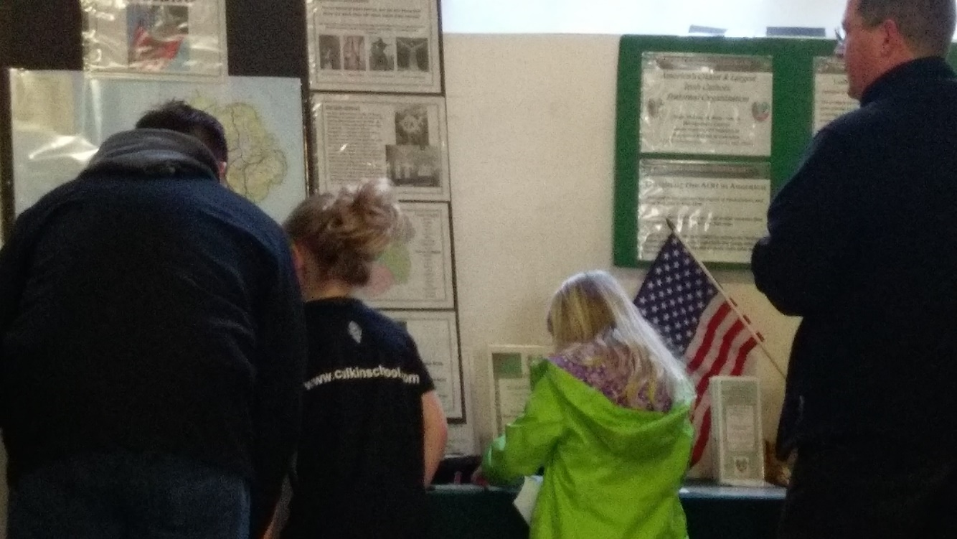
St Jerome’s Irish Festival

Slide 30
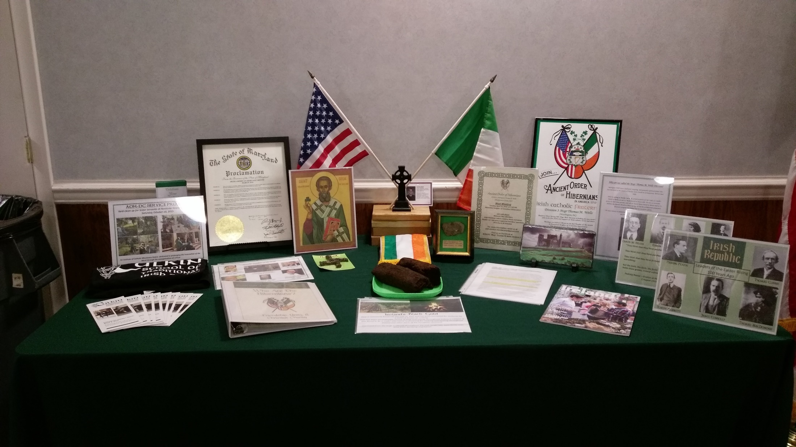
Rosensteel Knights of Columbus Knights/Hibernians St Patrick’s Day

Slide 32
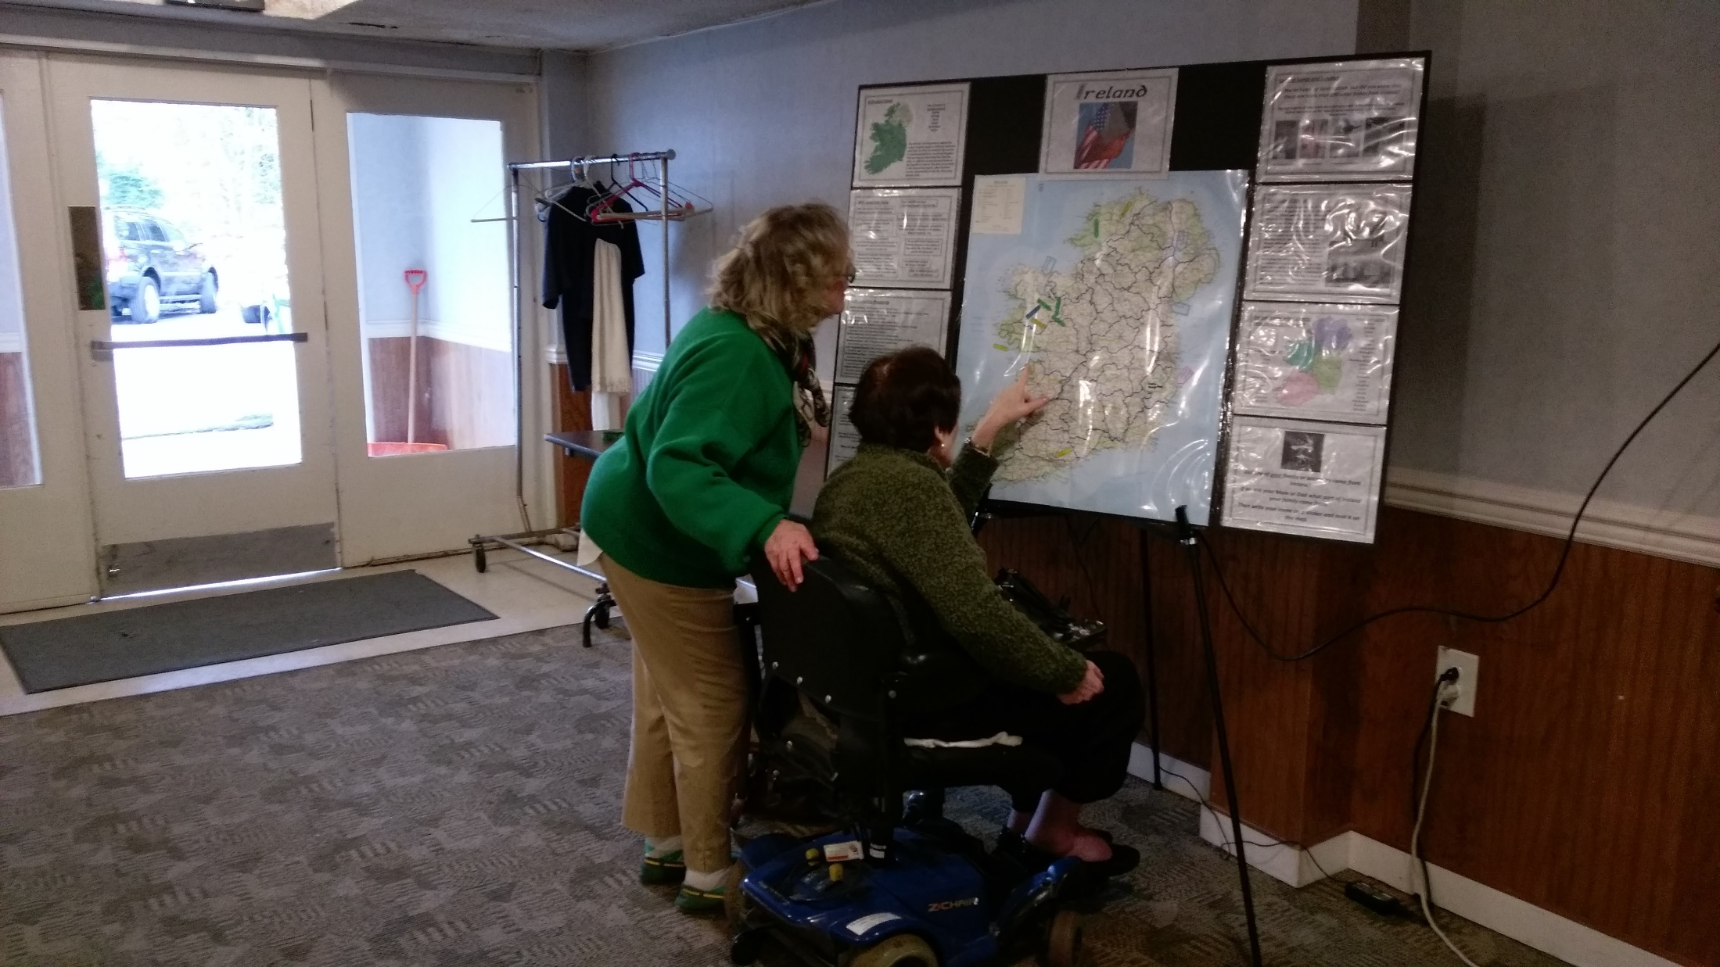
Rosensteel Knights of Columbus Knights/Hibernians St Patrick’s Day

Slide 33
St Mary of the Mills Community Ministry Sunday

Slide 34
Culkin Feis November 5, 2016

Slide 35
Culkin Feis November 5, 2016

Slide 36
NYS Recruiting Tent

Slide 37
Wind Banners

Slide 38
Module
Three
THE AOH GETS YOUNGER

Slide 39
Taking ‘Ancient’ Out of Ancient Order of Hibernians:
Recruiting On Campus & Retaining Millennials

Slide 40
TOPICS
Chasing Millennials: Breaking Out of the Add/Drop Cycle
Fishing On Campus: Overcoming Institutional Challenges
Set The Hook: Identifying & Solving Recruitment Challenges
Keep ‘Em On The Line: Retaining Recent Grads & Millennials

Slide 41
Objectives
Identify Recruitment Targets & Opportunities
Provide Solutions to Campus Recruitment
Identify Challenges of Millennial Recruitment
Promote Strategies For Successful Recruitment & Retention of Millennials

Slide 42
Chasing Millennials
Meet Potential Recruit
Sign Him Up/Swear Him In
Collect Dues/Send Meeting Notice
Drop From Roster
Radio Silence (1-2 years)
Where? Who?
Campuses
Festivals/Parades
Pubs
GAA/Rugby Teams
Professional / Networking Orgs
Fraternal / Service Orgs (KoC/PES/FOP)
Churches

Slide 43
Fishing On Campus
CATHOLIC/CHRISTIAN
CHALLENGES
PUBLIC/PRIVATE
CHALLENGES
Smaller Enrollment
Competition For Publicity/Resources
Established Organizations
Mission Redundancy
Ban on Fraternal Organizations
Bureaucratic Red Tape
Rejection of Catholic / Christian Identity
Lack of Qualified Candidates
Bureaucratic Red Tape
Non-Discrimination Policies
Limited Religious Support
Limited Outreach Potential
Suppression of Religious Organizations & Ideals

Slide 44
Fishing On Campus
College Division Creation
Identify:
Sustainable Population
Student Leaders
Faculty Allies
Key Administrators
Determine:
Administration Support
Necessary Paperwork
Student Organization Policies
Partnership Opportunities
Provide:
Mentoring
Financial, Political & Logistical Support
Meeting Location (if needed)
Cosponsored Activities
Consider:
Joint Meetings
Setting Reasonable Expectations For Involvement
Official/Unofficial Institutional Affiliation
Turnover / Attrition

Slide 45
Campus Challenges
Where should we look for potential members?
Catholic (Newman) Centers
Campus Ministry
Pro-Life Organizations
Student Orgs Devoted To Culture, History, Literature.
Target Like-Minded Organizations That Share AOH/Catholic Values.

Slide 46
Campus Challenges
What If The Administration Denies Creation Of A Division?
Support The Creation Of A Cultural Club/Association (ie CUA Gaels)
AOH/LAOH Support Can Lead To “Feeder” Organizations
Sponsor Speaker Series, Irish Events, and IAHM Celebrations
Push For Creation Of Irish History/Language Classes
Advertise In Student Papers, Centers, Campus Ministry/Newman Centers.

Slide 47
Campus Tips
Speak To Campus Ministry First
Getting Support of Local Catholic Leaders Can Save Time & Provide Access to Friendly Students/Administrators.
Line Up Faculty Support
Having a Pre-Arranged Faculty Advisor Can Decrease Formation Time While Providing Help Navigating Administration Requirements.

Slide 48
Campus Tips
Research “Posting” Policies
Before Forming A New Division, Research Campus Requirements For Flyers, Advertisements, and Outside Groups Organizing On Campus.
Consider Cross-Community Divisions
If A Student Only Plan Fails, Consider Forming A Multi-Generational Division.
Younger Members Bring Energy, While Older Members Provide Stability.

Slide 49
Set The Hook
Young Men Don’t Have Interest In Joining Organizations Like The AOH
Meet Young Men Where They Are
Focus on Interests Like Culture, History, Genealogy, Service, and Faith
Keep Your Pitch Flexible & Light
Use Inclusive Terminology (i.e. Gatherings > Meetings)
DON’T SCARE THE RECRUIT!

Slide 50
Set The Hook
Beware The “JOINER”
Set Firm, Realistic Expectations of Involvement
Discuss Responsibilities, Be Prepared To Actively Support
Find A Leader, Mentor Him
Create A Leadership Team To Help Support The Leader

Slide 51
Set The Hook
College Recruits & Divisions Lack The Resources For Full Participation
Offer Discounted Dues / Waive Per Capita
Create Division Treasury or Offer Matching Funds
Cosponsor Events
Provide Transportation To Events
Constant Outreach / Invitations

Slide 52
Keep ‘Em On The Line
Recent Grads & Mid/Late Millennials Have Different Needs & Motivations
Focus Will Be On Career Advancement, Personal Relationships, Emotional Growth & Social Status
Sense of Belonging, Respect & Meaningful Impact Are Desired
Have Entered a Period of Transition, Lack of Stability (Involvement Will Waiver)
Will Grow Bored If Not Engaged

Slide 53
Keep ‘Em On The Line
Be A Brother!
Fraternal / Service Organizations Provide Networks and Mentors
Take Notice of Life Events. Accept That Changes Will Occur
Provide Social Escapes
Endeavor To Be An Addition, Not Distraction In Their Life

Slide 54
Keep ‘Em On The Line
Bridge The Technology Gap
Make It Easier To Stay In Contact
Divisions Must Have An Internet Presence
Utilize Social Media (Facebook, Twitter, Instagram)
E-Communication (Text, Email, Skype)
Promote E-Forms, Improve Access and Submission

Slide 55
QUESTIONS ?
COMMENTS ?

Slide 56
MODULE
FOUR
RECRUITING THE MILITARY

Slide 57
Military Membership Form 11 – Line 13
Coast Guard - National Guard – Army –Navy-Marines-Air Force (No Dues)
MWR – Moral Welfare Recreation-Assigned Duty/Outreach
Facilities
Commanding Officer

Slide 59
Why Military Members?
-They are Driven and Motivated
-Thrive on Teamwork
-Problem Solvers
-May want an outlet from base life
-They are transferable to other divisions
-Active Military don’t pay dues

Slide 60
MODULE
FIVE
Emerging Technology in Recruitment and Retention

Slide 61
SOCAIL MEDIA
GEO TARGETING
-Geo Targeting is a geo marketing and internet marketing method of determining the geolocation of a website visitor and delivering different content to that visitor based on his or her location, such as a country, region/ state, city zip code or FACEBOOK LIKES

Slide 62
CALLING POSTS
-Robo calls from your Division announcing an event, wake meeting Etc.
-Good for smaller Divisions
-Good for Divisions with older member who do not use email

Slide 63
Mass Email Services
Constant Contact
Mail Chimp
Clevereach
Good for Large Divisions
Fairly Inexpensive

Slide 64
Public Websites/ Social media
-POST AS MUCH CONTENT AS POSSIBLE
-POST PHOTOS OF EVENTS

Slide 65
WEBINARS
On line meetings and Training

Slide 66
Use of Statistical Atlas
www.statisticalatlas.com
Based on U.S. Census Bureau numerous surveys collecting volumes of statistics about American homes, Families, occupation, ETHNICITY and scores of other subjects
Recruiting Use- Target areas with high density of Irish decent

Slide 69
MODULE 6
ORGANIZING THINK TANK
Tim McSweeney
newjack12007@yahoo.com
518-961-1588

Slide 70
Help Us Improve

